Slide 1
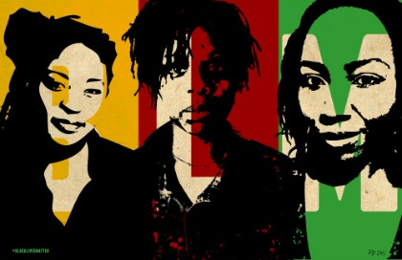
#BlackLivesMatter
Anti-Black Violence Movement during the Age of Obama & Trump, Spr 2019, Prof. S. King

Slide 2
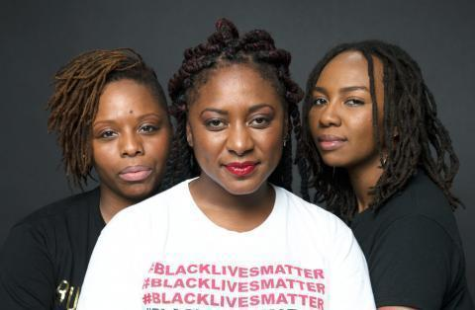
#BlackLivesMatter Project
The #BlackLivesMatter campaign was founded in 2013 by three black women, Patrisse Cullors, Alicia Garza, and Opal Tometi in the wake the acquittal of George Zimmerman, who fatally shot Trayvon Martin, an African American 17 year old in Sanford, Florida in February 2012. They are one of many organizations that are part of the BLM movement

Slide 3
Antecedents
#BlackLivesMatter campaign builds on a long tradition of organization and mobilization against anti-black violence in the black freedom movement, including the Anti-slavery and Abolitionists and Anti-lynching movements (along with the NAACP, NOI, CORE, SNCC and others). For antecedents in the 21st century, we might include the Jena 6 campaign (2006), Sean Bell (2006), and Troy Davis (2009-2011), and Oscar Grant (2009).
Consider the impact of Emmett Till’s murder on Anne Moody:
“Before Emmett Till’s murder, I had known the fear of hunger, hell, and the Devil. But now, there was a new fear to me – the fear of being killed just because I was black.”

Slide 4
Ronal Reagan Era (1981-89)
President Ronald Reagan (Republican) advocated the “small government” and “trickle-down” approach to politics—that is, the idea that by citizens paying low taxes (including especially the wealthy and businesses), they will create more businesses and therefore more employment and wages.
Reagan helped create the “welfare queen” trope.
Ronald Reagan’s /Anti-Drug Abuse Act, 1986 and 1988 -nationwide mandatory minimum (Reagan), which creates mandatory minimum (at least 10 years) for possession of at least 1 kilogram of heroin or five kilograms of cocaine; also punishment of crack and power cocaine (1/100) or (5 grams to 500 grams).

Slide 5
William J. Clinton (1993-2001)
President Bill Clinton supporting “New Democrat” politics, that is, a centrist Democratic that tried to both reclaim that “new deal coalition” and embrace the “small government” politics of Republicans—supported punitive responses to crime. Hilary R. Clinton, supporting her husband, used the now notorious phrase “super predators” to describe blacks that the VCCA targeted.
At the same time, many black politicians and citizens supported the legislation as means to protect them from crime within their neighborhoods.
Violent Crime Control Act and Law Enforcement Act, 1994
-10 billion for federal prison construction (only states that toughened sentencing)
Expanded “community” police at local and state levels
Prevent Violence Against Women
3 strikes mandatory life sentence (violent & drug trafficking)

Slide 6
Mass Incarceration is about politics not just “crime.”
Currently, there is a political consensus that mass incarceration has become too expensive for the nation.
This consensus too often does not always address the racial unfairness of the system, and that it has disproportionately targeted people of color and poor people. In other words, there’s an evasion of racism, despite willingness to admit that the system does not work.

Slide 7
During the Obama era, after the uprisings and responses to killings of black people, citizens of embattled cites, such as Ferguson, Baltimore, and Cleveland have urged the federal government, specifically the Dept. of Justice (DOJ)to intervene. In the past few weeks, however, Attorney General Jeff Sessions has, more or less, promised dismantle consent decrees, legal reforms that the Department of Justice have “negotiated with troubled police forces.”

Slide 8
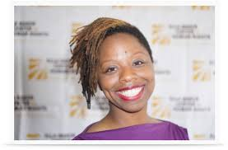
Patrisse Cullors
Movement history:
Native of Los Angeles, organizing in the LGBTQ since she was a teenager. An anti-incarceration activist, founder of a prison-reform organization, Dignity and Power Now.

Slide 9
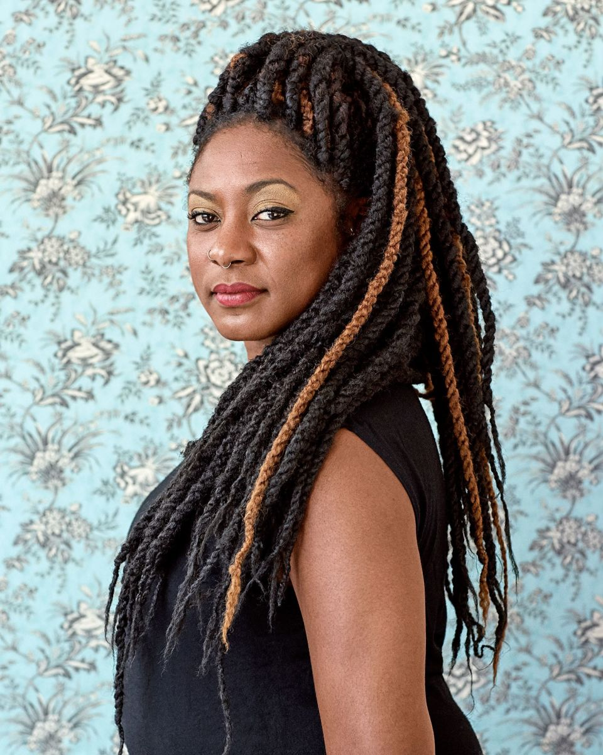
Alicia Garza
Movement history:
Executive Director of People Organized to Win Employment Rights (since 2003).

Slide 10
Opal Tometi
Movement history:
Executive Director of Black Alliance for Just Immigration, an immigrant-rights group in New York City.

Slide 11
Philosophy Heritage
Ella Baker, director of branches of the NAACP, director of SCLC, and SNCC. According to historian Barbara Ransby, Baker’s biographer, she would go into small towns and say:
“Whom are you reaching out to?’ And she’d tell them that if you’re not reaching out to the town drunk you’re not really working for the rights of black people. The folk who were getting rounded up and thrown in jail had to be included.”

Slide 12
Philosophy: “We Affirm that All Black Lives Matter”
Movement Principles:
Diversity, Restorative Justice, Unapologetically Black, Globalism, Black Women, Collective Value, Transgender Affirming, Black Villages, Empathy, Black Families, Queer Affirming, Loving Engagement, and Intergenerational

Slide 13
“For us, #BlackLivesMatter is really a re-humanization project. It's a way for us to love each other again, to love ourselves, and to project that love into the world so that we can transform it.”
Meet the Women Who Created #BlackLivesMatter
“Black Lives Matter is a unique contribution that goes beyond extrajudicial killings of Black people by police and vigilantes. It goes beyond the narrow nationalism that can be prevalent within some Black communities, which merely call on Black people to love Black, live Black and buy Black, keeping straight cis Black men in the front of the movement while our sisters, queer and trans and disabled folk take up roles in the background or not at all. Black Lives Matter affirms the lives of Black queer and trans folks, disabled folks, Black-undocumented folks, folks with records, women and all Black lives along the gender spectrum. It centers those that have been marginalized within Black liberation movements. It is a tactic to (re)build the Black liberation movement.”
Alicia Garza, “A Herstory of the #BlackLivesMatter Movement” October 7, 2014

Slide 14
Intersectionality
In 1989, legal scholar and race theorist Kimberle Crenshaw formulated the concept “intersectionality,” which speaks to the ways race, class, gender, sexuality, among other ways of identification mutuality influence and shape their experience in the society. Intersectionality is especially significant, since queer organizers, such as Garza and Cullors, have been historically marginalized.
“Our work is heavily influenced by Crenshaw’s theory, . . . People think that we’re engaged with identity politics. The truth is that we’re doing what the labor movement has always done—organizing people who are at the bottom.” Alicia Garza
“Black women hold it down all the time and we have been the architects of the movement — not just this current one, but previous ones — since the beginning. So we decided very early on that we weren't going to allow our stories and the stories of black women to be erased.” Patrisse Cullors
“I often think of Audre Lorde and her saying that we don't live and we don't fight for one specific struggle. We live intersectional lives and so I think that this movement has to reflect that. All of who we are, all of our dignity, and all of our brilliance.” Opal Tometi

Slide 15
Allies
“San Francisco broke my heart over and over. White progressives would actually argue with us about their right to determine what was best for communities they never had to live in.” Alicia Garza
“And, to keep it real–it is appropriate and necessary to have strategy and action centered around Blackness without other non-Black communities of color, or White folks for that matter, needing to find a place and a way to center themselves within it. It is appropriate and necessary for us to acknowledge the critical role that Black lives and struggles for Black liberation have played in inspiring and anchoring, through practice and theory, social movements for the liberation of all people. The women’s movement, the Chicano liberation movement, queer movements, and many more have adopted the strategies, tactics and theory of the Black liberation movement. And if we are committed to a world where all lives matter, we are called to support the very movement that inspired and activated so many more. That means supporting and acknowledging Black lives.” Garza

Slide 16
Some of the others organization part of the BLM Movement
Black Youth Project 100 (BYP 100)
Million Hoodies Movement for Justice
Dream Defenders
United We Dream

